Slide 1

Fundamentals of Coding
Session 1

Slide 2
Course Objectives
An understanding of how coding or programming solutions can be useful to you and your job
A demonstration of some of the applications of programming already taking place within Prices
An introduction to some of the fundamental concepts of programming common to most languages
Intro to Computer Science
Intro to Programming Language concepts
Introduction to design concepts and how to write good code
Glossary of terms
An introduction to some Python specific concepts
Built-in functions
Data Types and uses
Modules and packages
An explanation of the key programming tools used within the ONS and how to get started using them

Slide 3
What we’re learning today
A whirlwind introduction to Computer Science
A whirlwind introduction to some programming concepts
Programming/coding jargon
An introduction to Python as a language

Slide 4
Future learning
Introduction to some coding basics and Python specific concepts
How to write and execute your first program
How to setup the artifactory for installing packages
Demo of Spyder IDE and why it’s useful for coding
A demo on how to find and fix bugs using a ‘debugger’
Introduction to design concepts: how to write better code
Other hints and tips that have been useful to me

Slide 5
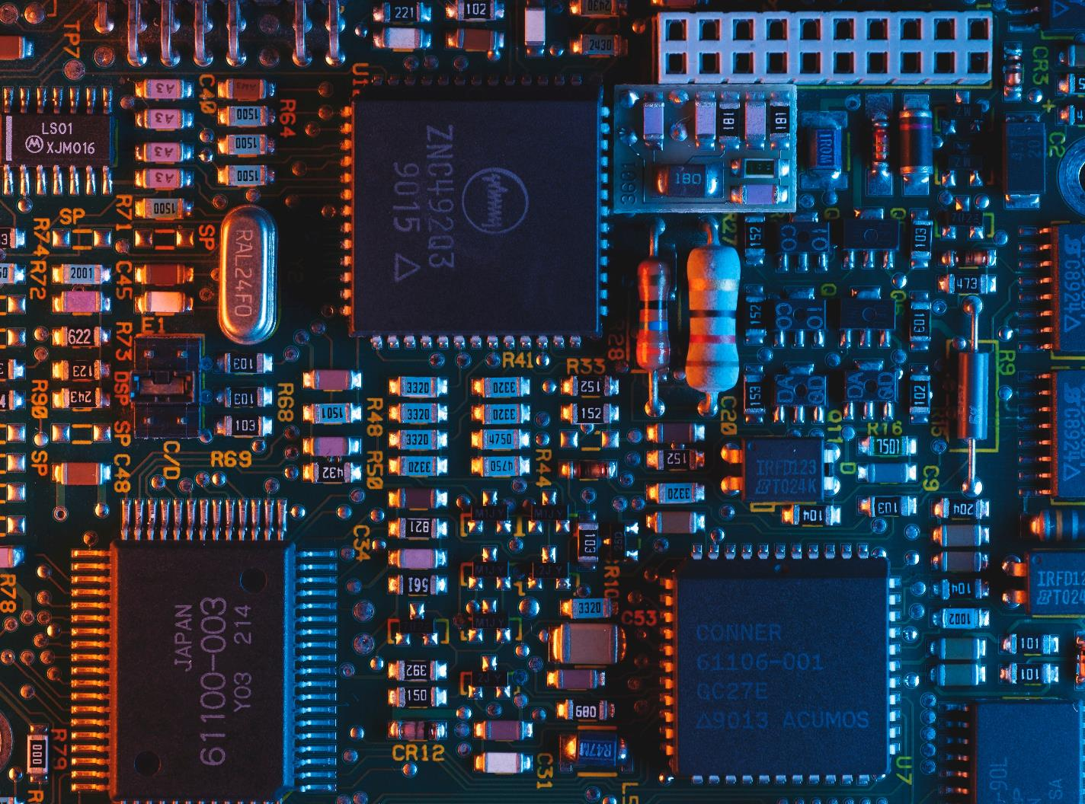
Why are we learning coding?

Slide 6
Current tools used by ONS
The main tools being used are:
Microsoft Excel
A spreadsheet that features calculation, graphing tools, pivot tables and a macro programming language (VBA).
SPSS (Statistical Package for Social Sciences)
A software package for interactive, or batched, statistical analysis.
SAS (Statistical Analysis System)
A statistical software suite for advanced statistical analytics.

Slide 7
Current tools used by ONS
Why these technologies are being phased out for production systems:
SAS and SPSS
Excel
Limited customisation options and non-functional outputs
Not necessarily compatible with DAP
Expensive Licenses
Struggles to handle large data volumes
Not kept pace with technological advancements
Primitive scripting language

Slide 8
Why is it useful to know some coding fundamentals?
You can recognise where there might be opportunity to automate repetitive and time consuming tasks
You can communicate with specialists about potential solutions more easily
You can modify and interact with existing solutions that have been built by a specialist
You can make use of libraries or cookbooks that have been developed by others
You can craft some of your own solutions to your problems
Make use of exciting open-source tools
Reduce copying errors from human error
More time to dedicate to more interesting work

Slide 9
Computer Science 101

Slide 10
Glossary of Terms
Computer Hardware
Term | Definition
Computer | A machine that can be instructed to carry out sequences of arithmetic of logical operations automatically.
Processor | The electronic circuitry within a computer that carries out the instructions of a computer program, also known as a central processing unit (CPU).
Memory / Primary Storage | The computer hardware integrated circuits that store information for immediate use in a computer or CPU. A common form is random-access memory (RAM). Operates at high speeds when reading and writing data or machine code. Volatile - only initialises at start-up and is wiped clean when powered down.
Secondary Storage | A form of storage that is not directly accessible by the CPU. Modern computers typically have hard disk drives (HDD) or solid-state drives. Significantly slower than primary storage. Non-volatile - retains data when power is shut off.

Slide 11
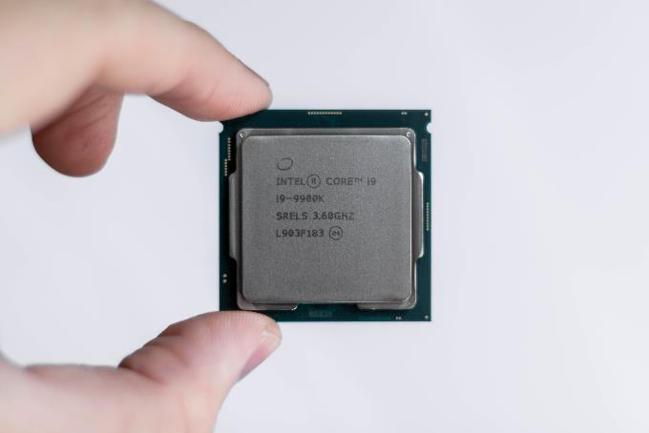
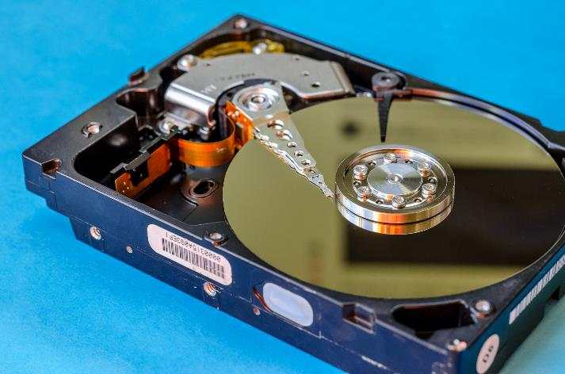
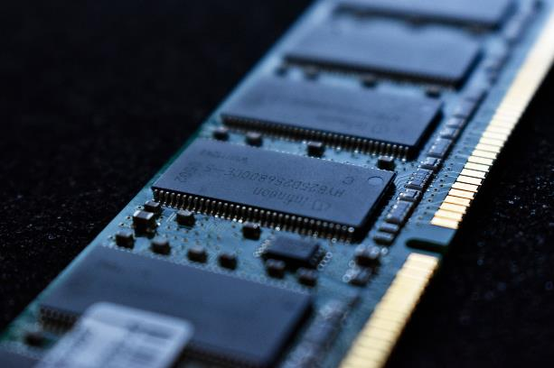
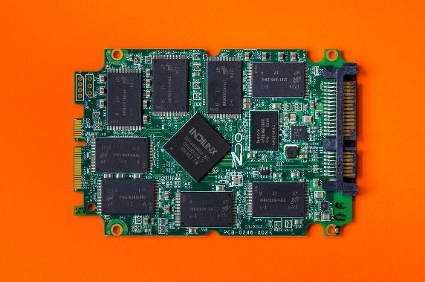
CPU, Christian Wiedige, Unsplash
Hard Disk Drive, Thomas Ryan, PC World
Solid State Drive, Thomas Ryan, PC World
RAM, Liam Briese, Unsplash

Slide 12
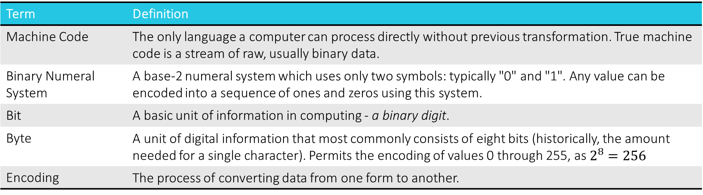
Glossary of Terms
Code
Term | Definition
Machine Code | The only language a computer can process directly without previous transformation. True machine code is a stream of raw, usually binary data.
Binary Numeral System | A base-2 numeral system which uses only two symbols: typically "0" and "1". Any value can be encoded into a sequence of ones and zeros using this system.
Bit | A basic unit of information in computing - a binary digit.
Byte | A unit of digital information that most commonly consists of eight bits (historically, the amount needed for a single character). Permits the encoding of values 0 through 255, as $2^{8}=256$
Encoding | The process of converting data from one form to another.

Slide 13
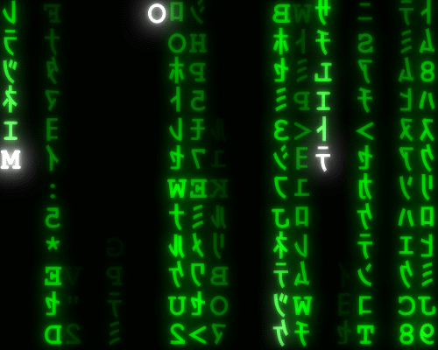
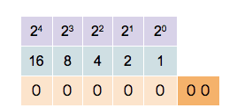
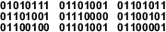
Types of Character Encoding
A character is a minimal unit of text that has semantic value.
ASCII – American Standard Code for Information Interchange
The first
Based on the English alphabet
Encodes 128 specified characters into 7-bit integers
Unicode
International standard
UTF-8 is the dominant encoding on the WWW
Covers 137,994 characters covering 150 modern and historic scripts, as well as symbols and emoji.
Morse Code!!
The word 'Wikipedia' represented in ASCII binary code, made up of 9 bytes (72 bits).

Slide 14
Glossary of Terms
Software
Term | Definition
Algorithm | An algorithm is a sequence of instructions to perform a computation. It can be expressed within a finite amount of space and time in a formal language. When executed it proceeds through a finite number of well-defined successive states, eventually producing an output and terminating at the final state.
Procedure | A series of computational steps to be carried out, also known as routines, subroutines or functions.
Computer Program | A collection of instructions that perform a specific task when executed by a computer.
Library | A collection of non-volatile resources used by computer programs, where the value typically lies in their reuse by multiple programs.
Software | A collection of computer programs, libraries, and related data used to operate computers.

Slide 15
Algorithms in real life
Our brain is constantly evaluating algorithms all day to enable us to perform key functions and tasks.
Consider driving to work:
Find your keys
Walk to the car
Get into the car
Start the engine
Pull out of the driveway (etc.)
Other examples:
Morning routine – wake up, drink water, brush teeth, etc.
Kicking a football – look at ball, place support leg next to ball, pull kicking leg back, etc.
Cooking a meal – Preheat the oven, gently heat some oil, chop some garlic, fry garlic for 1 minute, etc.
When thinking about how to implement an algorithm, it’s useful to think through the instructions in plain English first before attempting to code.

Slide 16
Glossary of Terms
File System
Term | Definition
Directory | A file system cataloguing structure which contains references to computer files or possibly other directories. Also known as "folders".
File | A computer resource for recording data in a computer storage device.
File formats | A file format is a standard way that information is encoded for storage in a computer file. It specifies how bits are used to encode information in computer storage.
Filename extensions | A popular method for operating systems to determine the format of a file based on the end of its name, specifically the letters following the final period. E.g. '.png', '.txt', '.xlsx'
Executable | Code, a file or a program that causes a computer to perform indicated tasks according to encoded instructions. Usually represented by a '.exe' filename extension.
Path | A general form of a file or directory that specifies a unique location in a file system, with levels typically separated using a delimiting character e.g. "/".

Slide 17
File System / Path Concepts
The file directory structure is usually represented as a hierarchical tree (represented upside-down).
The root folder (or “root”) of any directory is the ‘highest’ in the hierarchy. It is usually relative to a project or program, and contains all the files and folders for that directory.
A home directory is a file system directory containing files and folders for a given user of the system.
e.g. “C:\Users\edmunm”
The current working directory is the working directory that is currently in scope i.e. the folder where you are working.
e.g. “C:\Users\edmunm\projects
To specify file paths from the current working directory you don’t need the full path, just the path below
Rather than “C:\Users\edmunm\projects\ooh-python\ooh_na.py” instead “ooh-python\ooh_na.py”
To traverse up a file structure relative to the current working directory you can use a double period: “..”
“../Downloads” gets us to “C:\Users\edmunm\Downloads”

Slide 18
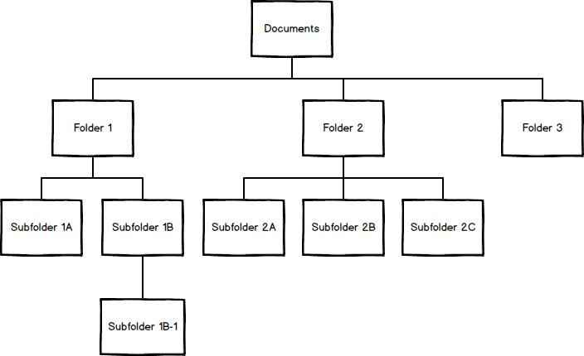
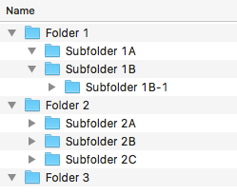

Slide 19
Glossary of Terms
Languages
Term | Definition
Programming Language | A formal language that consists of instructions for computers, typically used to implement algorithms or procedures.
Compiler | A computer program that translates computer code written in one programming language (the source language), into another language (the target language). It is primarily used to describe programs that translate source code from a high-level programming language.
Interpreter | A computer program that directly executes instructions written in a programming or scripting language, without requiring them to have been previously compiled into a machine language program.
Scripting language | A programming language for a special run-time environment that automates the execution of tasks.
Syntax | The spelling and grammar of a programming language. Computers expect instructions in an exact form - that form is called the syntax.
Semantics | Refers to the meaning of languages as opposed to their form i.e. what computer processes are instructed by a line of code with valid syntax and in what order.

Slide 20
Types of Programming Language
High-Level Programming Language
Low-Level Programming Language
A programming language with strong abstraction from the details of the computer.
In contrast to low-level, it may use natural language elements, be easier to use and automate (or hide) significant areas of computing systems such as memory management.
Examples:
A programming language that provides little of no abstraction from a computer's instruction set.
Commands or functions in the language map closely to the processor instructions or machine code.
Examples:
Machine Code
Assembly Language
Python
C#
Java
Ruby
Perl
Not relevant to us!

Slide 21
Types of Programming Language
Scripting Languages
“A programming language for a special run-time environment that automates the execution of tasks.”
Scripting languages are often interpreted (rather than compiled).
Sometimes referred to as "very high-level programming languages“
Examples:
Bash
Unix OS
VBA
Microsoft Office
JavaScript
Web Browsers

Slide 22
Programming Paradigms
A way to classify programming languages based on their features.
Procedural Programming
A procedural language is a computer programming language that follows, in order, a set of commands.
The focus of procedural programming is to break down a programming task into a collection of variables, data structures, and subroutines.
Examples: C, FORTRAN, Java, Pascal, Python, R
Object-oriented Programming
A programming paradigm based on the concept of "objects", which can contain data, in the form of fields (often known as attributes or properties), and code, in the form of procedures (often known as methods).
A feature of objects is an object's procedure can access and modify the data fields of the object with which their associated (they have a notion of "self").
Examples: Java, C++, Julia, Ruby, Python (optionally)
Many more!

Slide 23
Glossary of Terms
Programming Constructs
Term | Definition
Variable | A storage location paired with an associated name, which contains some known or unknown quantity of information referred to as a value. ~ "A container for values."
Value | The representation of some entity that can be manipulated by a program.
Constant | A value that cannot be altered by the program during normal execution.
Expression | A combination of one or more constants, variables, operators and functions that the programming language interprets and computes to produce another value. Similar to mathematical expressions, this process is called evaluation.
Function | A sequence of program instructions that performs a specific task, packaged as a unit. It can be reused and generalised. Depending on the programming language, they're also known as subroutines, procedures, routines or methods.
Name binding | An association of a name to an entity, such as a variable.

Slide 24
Programming Constructs
In Python…
You assign a value to a name using an “=“ which is an assignment operator.
name = my_value
The name given is now what is known as a variable i.e. the value it holds can vary.
The association of this name with the variable (an entity) is called name binding.
Rules on Naming
A variable can have a short name (like x and y) or a more descriptive name (age, carname, total_volume).
A variable name must start with a letter or the underscore character
A variable name cannot start with a number
A variable name can only contain alpha-numeric characters and underscores (A-z, 0-9, and _ )
Variable names are case-sensitive (age, Age and AGE are three different variables)

Slide 25
Glossary of Terms
Errors and Bugs
Term | Definition
Execute | To cause a program to run on a computer.
Runtime error / Exception | An error that occurs once the program has started to execute, preventing the program from continuing.
Syntax Error | An error in a program that makes it impossible to compile and run.
Logic / Semantic Error | An error in a program that produces incorrect results or causes unintended behaviour. Unlike a program with a syntax error, a program with a logic error is a valid program in the language.
Traceback | A report in Python containing the functions calls made in your code at a specific point that can be used to trace where errors occurred.
Bug | An error, flaw, failure or fault in a computer program or system that causes it to produce an incorrect or unexpected result. A logic error is one type of bug.

Slide 26
Introduction to Data Types
A data type or ‘type’ is an attribute of the data which tells the compiler or interpreter how the programmer intends to use the data.
A data type constrains the values that an expression, such as a variable or a function, might take.
The type defines the operations that can be done on the data, the meaning of the data, and the way values of that type can be stored.
Most programming languages support the following common data types:
integers
Booleans
characters
floating-point numbers (or “floats”)
alphanumeric strings
Most programming languages also allow the programmer to define additional data types, usually by combining multiple elements of other types and defining valid operations.

Slide 27
Introduction to Data Types
Definitions
Data Type | Definition | Examples
Integer | A number that can be written without a fractional component. | 7 -629 2,067,943
Boolean | A data type that has one of two possible values (usually denoted True or False). Primarily associated with conditional statements and equate to True=1, False=0. | True False
Characters | A character is a unit of information that roughly corresponds to a symbol in an alphabet in the written form of natural language – includes punctuation and whitespace. | ‘c’ ‘8’ ‘:’ ‘[‘ ‘ ‘
Floats | A representation of a real number that may or may not have a decimal point – used for greater precision than integers. | 0.002945 -7.78 18756.37465243
Strings | A sequence of one or more characters, typically denoted using double or single quotations depending on the language. | “Hello world!” “NP10 8XG” “6475”

Slide 28
Introduction to Data Types
Categorical Data
This is a data type defined within the pandas module.
A categorical variable takes on a limited, and usually fixed, number of possible values.
Categorical variables may be ordered i.e. … “Agree”, “Strongly Agree”
Categorical variables can save memory by encoding various string variables, storing the encoded values in the original address, then using a lookup table to get the original value.

Slide 29
Introduction to Data Types
Why data types are important
If a variable is not defined with the correct data type, the user may not be able to perform certain operations on it, for example:
Comparing a string with an integer: ‘age’ > 5
In Python this will generate a ‘TypeError’
Defining the right data type is an important step in ‘data cleaning’.
A common problem: a numerical column in Excel might contain the string ‘missing’ amongst the numerical data. When loading into a pandas DataFrame in Python, the column (Series) may have multiple types or the numerical data may be coerced to a string.
Changing from one type to another is called ‘type coercion’.

Slide 30
Scope and Namespace
Built-in
Global
Local
Term | Definition
Scope | The scope of a name binding is the region of a computer program where the binding is valid: where the name can be used to refer to the entity. Makes it possible for an identifier (name) to have different meanings at different scope levels.
Namespace | A system within Python to have a unique name for each and every object in Python. Makes it possible for an identifier (name) to have different meanings, depending on its namespace.
Types of Scope / Namespace

Slide 31
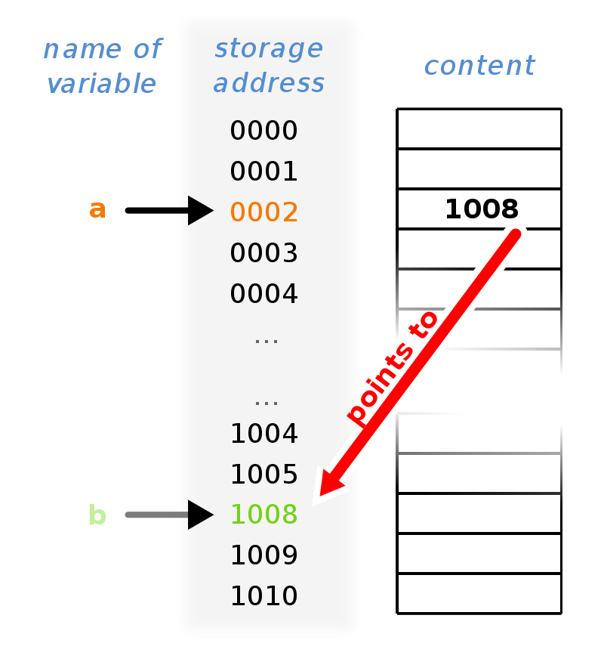
Pointers and Aliasing
Term | Definition
Pointer | A programming language object that stores the memory address of another value located in computer memory. Using pointers is typically much cheaper in time and space than copying and accessing the data itself.
Aliasing | Aliasing refers to the situation where the same memory location can be accessed using different names or identifiers. A variable's storage location may be referred by several different identifiers.

Slide 32
Python

Slide 33
What is Python?
“Python is an interpreted, high-level, general-purpose programming language.”
Python is an open-source programming language created by Guido Van Rossum and first released in 1991.
Open-source means that it is freely available to download and use and that the source code is available.
Python is general-purpose:
This means that is designed to be used for writing software in the widest variety of applications
As well as statistical analysis, Python is commonly used for:
Web development (server-side)
Software development
Mathematics
System scripting
Machine learning
Python supports multiple programming paradigms, including procedural and object-oriented programming.

Slide 34
What can Python do?
Python can be used on a server to create web applications.
Python can be used alongside software to create workflows.
Python can connect to database systems. It can also read and modify files.
Python can be used to handle big data and perform complex mathematics.
Python can be used for rapid prototyping, or for production-ready software development.
i.e. “general-purpose”

Slide 35
Why would we use Python?
Python is cross-platform (works on Windows, Mac, Linux, Raspberry Pi, etc).
It has a similar syntax to the English language (easier for non-developers to use)
It has syntax that allows developers to write programs with fewer lines than some other programming languages.
Python runs on an interpreter system, meaning that code can be executed as soon as it is written. This means that prototyping can be very quick.
Python can be treated in a procedural way, an object-orientated way or a functional way.

Slide 36
Python Syntax
Compared to other programming languages
Python was designed for readability, and has some similarities to the English language with influence from mathematics.
Python uses new lines to complete a command, as opposed to other programming languages which often use semicolons or parentheses.
Python relies on indentation, using whitespace, to define scope; such as the scope of loops, functions and classes. Other programming languages often use curly-brackets for this purpose.

Slide 37
Anaconda
Python ships as part of the open-source Anaconda Distribution, which is the industry standard for statistical analysis and data science.
Ships with latest version of Python (3.7.4)
Pre-installed with scientific number and data packages:
NumPy, Pandas, SciPy
Pre-installed with machine learning packages:
scikit-learn, TensorFlow
Pre-installed with visualisation packages:
Matplotlib, Bokeh
Also installs the Spyder IDE (Integrated Development Environment) and Jupyter Notebooks as standard.

Slide 38
Python relevance for Prices
Enables you to…
Write your own code
Create data frames / data sets
Import data from Excel, CSV files, or others (such as SPSS or SAS)
Perform statistical analysis with built-in functions
Perform statistical analysis with user-defined functions
Create and export graphics files for external use
Import a variety of packages for extending capability

Slide 39
Comparison to R
R is an open-source programming language for statistical computing and data analysis.
Not general-purpose
It is widely used among statisticians and data miners (machine learning engineers)
R is also an interpreted language and is multi-paradigm
Also supports procedural and object-oriented paradigms
R is also a high-level programming language designed for readability
R is also extended with packages
The creators of the pandas module in Python and the tidyverse suite of packages in R often collaborate to make ideas, concepts and function names portable across the languages
If you know one, you’ll generally be OK in the other.
In a statistical context, use of one over the other is largely down to preference.
Prices are standardising around Python

Slide 40
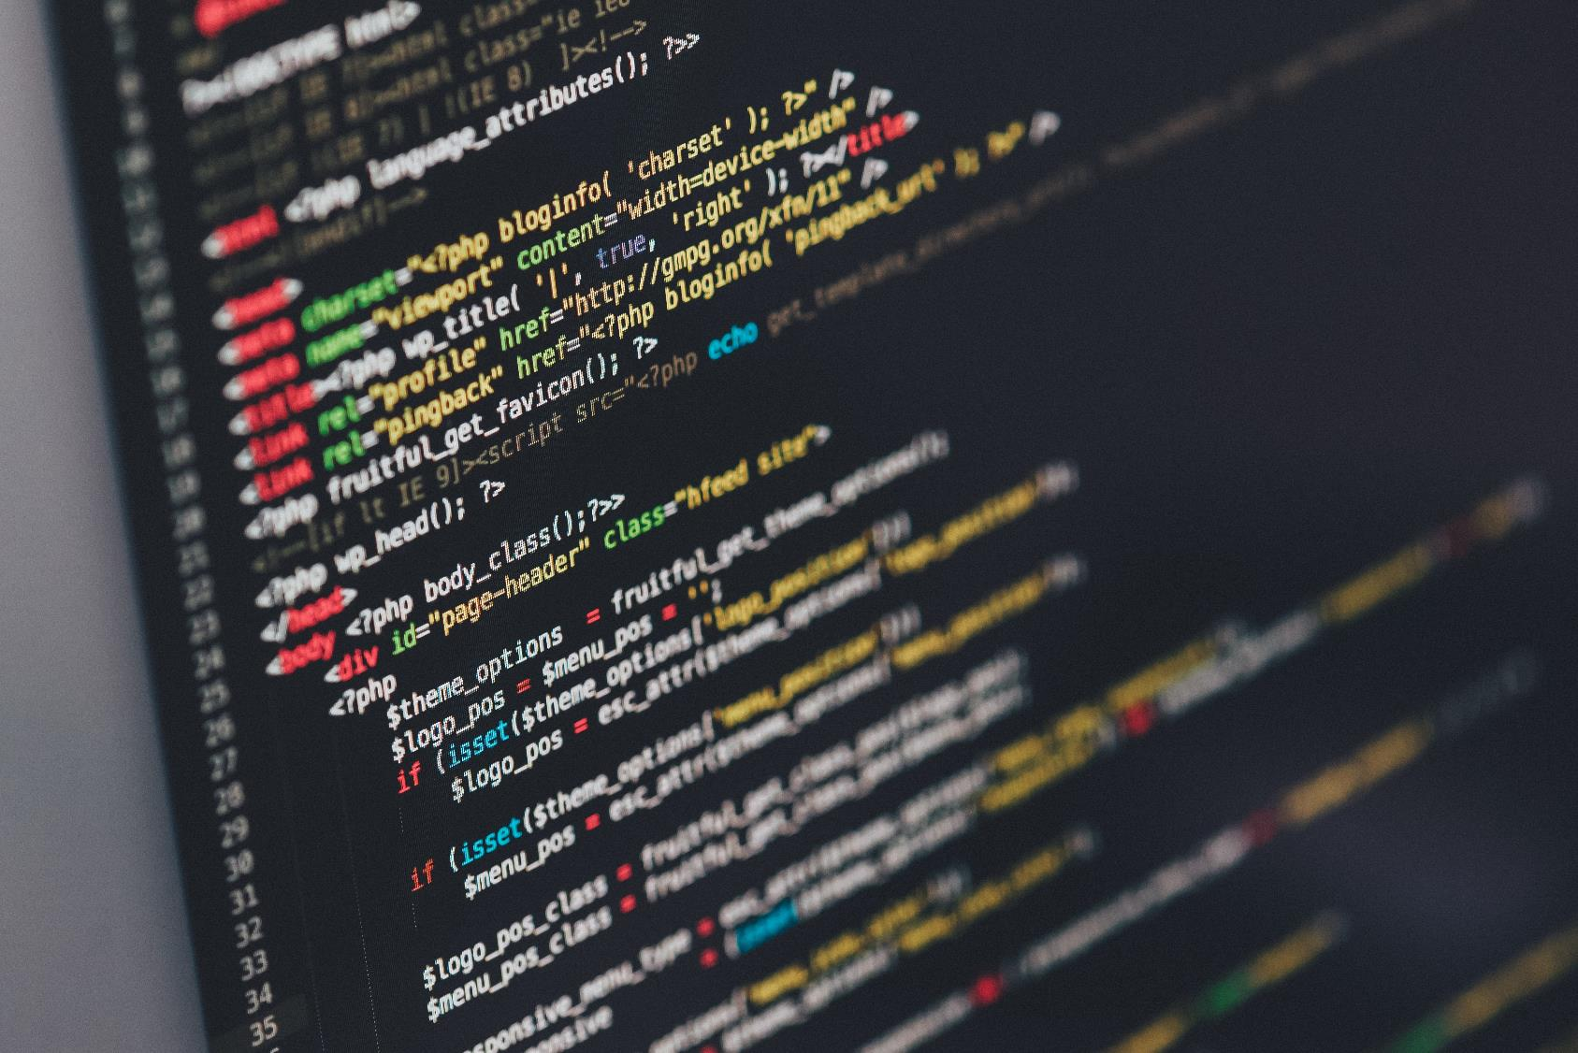
End of Session 1

Slide 41
Coming Up
Introduction to some coding basics and Python specific concepts
How to setup the artifactory for installing packages
Demo of Spyder IDE and why it’s useful for coding
A demo on how to find and fix bugs using a ‘debugger’
Introduction to design concepts: how to write better code
Other hints and tips that have been useful to me

Slide 42

Thank You

Slide 43
Coding Basics in Python

